Slide 1






DataSHIELD: taking the analysis to the data not the data to the analysis
Paul Burton
University of Bristol, DataSHIELD Research Program
McGill University, OICR, Maelstrom Research
MRC Epidemiology Unit, Cambridge
The Norwegian Institute of Public Health, Dept of Epidemiology
Technical University of Eindhoven
University College, London
University of Bristol, School of Social and Community Medicine
WUN DAPPER Workshop: 22nd-23rd August 2016, Bristol
Satellite meeting to the 2016 International Population Data Linkage Conference (IPDLN)

Slide 2
Constraints and barriers to sharing and combining individual-level data (microdata)
Ethico-legal or other governance restrictions
Maintaining control of intellectual property
Physical size of data

Slide 3
The DataSHIELD approach
Take “analysis to data” ….. not “data to analysis”
Leave the data to be analysed on local servers behind the firewalls where they usually reside
The analysis centre co-ordinates parallelised analyses in all studies simultaneously
Tie analyses together with non-disclosive information: (i) non-disclosive statistics of an appropriate nature (ideally sufficient statistics); (ii) encrypted information that can be decrypted as a final step of processing
Analytic processing - and options for disclosure control - located with the data

Slide 4
DataSHIELD:
Data Aggregation Through Anonymous Summary-statistics from Harmonized Individual-levEL Databases
Horizontal DataSHIELD
  Different sources hold all variables but on different individuals
  Secure meta-analysis (IPD and Study-Level)
  Secure single-site analysis
Vertical DataSHIELD
  Different sources hold different variables on the same individuals
  Secure processing and analysis of linked data without bringing the data together

Slide 5
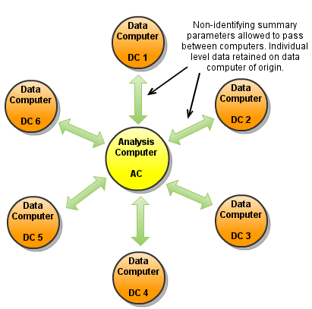
Horizontal DataSHIELD
One step analyses: e.g. ds.table2D - request non-disclosive output from all sources
Multi-step analyses: e.g. ds.lexis – set up and then request
Iterative analyses: e.g. ds.glm - parallel processes linked together by non-identifying summary statistics – e.g. for glm = score vectors and information matrices
Can be used as equivalent to full individual level analysis or to study level meta-analysis

Slide 6
DataSHIELD: a novel solution
Analysis commands (1)
b.vector<-c(0,0,0,0)
glm(cc~1+BMI+BMI.456+SNP,
family=binomial,
start=b.vector, maxit=1)

Slide 7
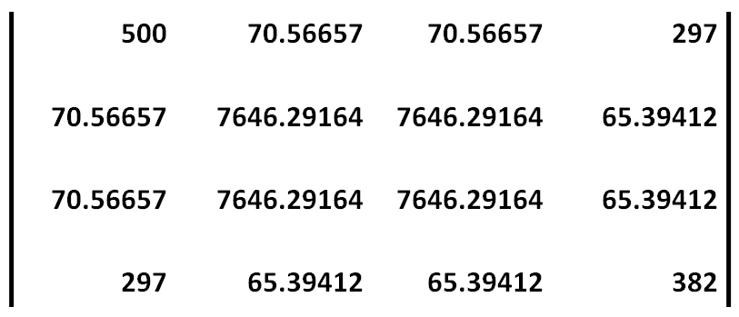
DataSHIELD: a novel solution
[36, 487.2951, 487.2951, 149]
Summary Statistics (1)
Summary Statistics (1)
Score vector _{Study 5}
Score vector _{Study 5}
Information Matrix _{Study 5}
Information Matrix _{Study 5}

Slide 8
DataSHIELD: a novel solution
[36, 487.2951, 487.2951, 149]
Summary Statistics (1)
Summary Statistics (1)
Score vector _{Study 5}
Score vector _{Study 5}
Information Matrix _{Study 5}
Σ
Information Matrix _{Study 5}

Slide 9
DataSHIELD: a novel solution
Analysis commands (2)
b.vector<-
c(-0.322, 0.0223, 0.0391, 0.535)
glm(cc~1+BMI+BMI.456+SNP,
family=binomial,
start=b.vector, maxit=1)

Slide 10
and so on .....

Slide 11
DataSHIELD: a novel solution
Updated parameters (4)
Final parameter estimates
Coefficient | Estimate | Std Error
Intercept | -0.3296 | 0.02838
BMI | 0.02300 | 0.00621
BMI.456 | 0.04126 | 0.01140
SNP | 0.5517 | 0.03295
Σ

Slide 12
DataSHIELD analysis
Direct conventional analysis
Coefficients:
Estimate Std. Error
(Intercept) -0.32956 0.02838
BMI 0.02300 0.00621
BMI.456 0.04126 0.01140
SNP 0.55173 0.03295
Does it
work?

Slide 13
DataSHIELD analyses
Conventional analysis
Does it
work?
Individual level meta-analysis
Association of
diabetes with
BMI>30 in 9 HOP studies
Random effects study level meta-analysis

Slide 14


Horizontal DataSHIELD: current implementation
Server-side functions
Client-side functions
Individual level data never transmitted or seen by the statistician in charge, or by anybody outside the original centre in which they are stored.
Opal
Finrisk
R
Data server
Data server
Web services
Opal
Prevend
BioSHaRE
web site
Opal
1958BC
Web services
Web services
Data server
R
R
R
Web services
Analysis
client

Slide 15


Vertical
DataSHIELD
500 | 70.56657 | 70.56657 | 297
70.56657 | 7646.29164 | 7646.29164 | 65.39412
70.56657 | 7646.29164 | 7646.29164 | 65.39412
297 | 65.39412 | 65.39412 | 382
IM₅:
Regression coefficients = X^{T}Y/ X^{T}X
X^{T}X: Need to calculate
Opal
NHS
R
X_{A}X_{A} | X_{A}X_{B} | X_{A}X_{C}
X_{A}X_{B} | X_{B}X_{B} | X_{B}X_{C}
X_{A}X_{C} | X_{B}X_{C} | X_{C}X_{C}
Data computer
X_{B}
M_{B}
X_{A}X_{B}
X_{A1} * X_{B1} ₊
X_{A2} * X_{B2} ₊
X_{A3} * X_{B3} + ……
Data computer
Web services
Data computer
Opal
ALSPAC
Opal
Education
Web services
Web services
M_{A}
R
M_{C}
X_{A}
Analysis
Computer
R
R

Slide 16
Vertical
DataSHIELD
500 | 70.56657 | 70.56657 | 297
70.56657 | 7646.29164 | 7646.29164 | 65.39412
70.56657 | 7646.29164 | 7646.29164 | 65.39412
297 | 65.39412 | 65.39412 | 382
IM₅:
Regression coefficients = X^{T}Y/ X^{T}X
X^{T}X: Need to calculate
M_{B}
Opal
NHS
R
X_{A}X_{A} | X_{A}X_{B} | X_{A}X_{C}
X_{A}X_{B} | X_{B}X_{B} | X_{B}X_{C}
X_{A}X_{C} | X_{B}X_{C} | X_{C}X_{C}
Data computer
X_{B}
M_{A} X^{T}_{A}
Data computer
M_{A}X^{T}_{A}X_{B}M_{B}
Data computer
M_{A}
Opal
ALSPAC
Opal
Education
Web services
X_{A}
R
Analysis
Computer
R
R
(M_{A})⁻¹ M_{A}X^{T}_{A}X_{B}M_{B} (M_{B})⁻¹ = X_{A}X_{B}

Slide 17
Why DataSHIELD?
Horizontal DataSHIELD multi-site
  Secured IPD meta-analysis or study-level meta-analysis where different studies hold the same variables on different individuals
  Data remains behind firewall of study holding data (but could be a formal repository) and is invisible and unobtainable externally. Appropriate disclosure settings under control of data controller
  Open-source freeware
Horizontal DataSHIELD single site
  Open-source freeware approach to creating a secure data enclave
Vertical DataSHIELD
  Ultra-secure analysis of very sensitive linked data where no source is prepared for its linked data to be held by any other sources or a trusted third party
  Securing the linkage process itself (possibly!)
Single site Horizontal DataSHIELD
  Post-publication “open access” to sensitive data
  “Open access” to simple descriptive stats from rigorously governanced studies
  Analytic access to sensitive (but not ultra-sensitive) linked data
  Analytic access to data collected by researchers in resource-poor regions

Slide 18
A proposal: securing linked data on Farr/ADRN secure enclave behind Horizontal DataSHIELD
Individual level data or disclosive analysis not transmitted or seen outside repository
SUMMARY STATISTICS
SV₅: [36, 487.2951, 487.2951, 149]
500 | 70.56657 | 70.56657 | 297
70.56657 | 7646.29164 | 7646.29164 | 65.39412
70.56657 | 7646.29164 | 7646.29164 | 65.39412
297 | 65.39412 | 65.39412 | 382
IM₅:
ALSPAC data linked to National Pupil database
R
User 1
User community
Web services
Web services
R
Web services
Farr
ADRN
Portal
Linked datasets in secure enclave
R
User 2
Web services
Web services
NHS WALES
Outpatient data
Emergency dept
Patient episode database
UK Biobank
R
User 3
R

Slide 19
THANK YOU FOR LISTENING

