Slide 1
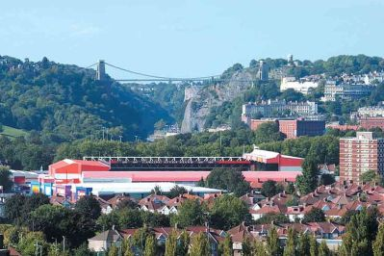
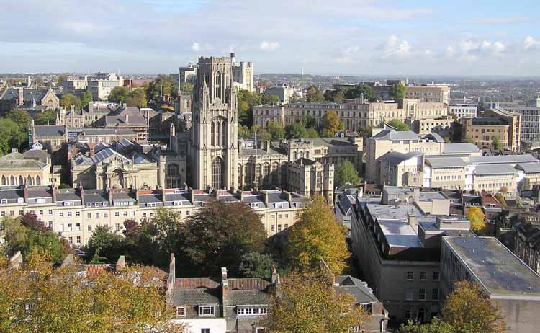
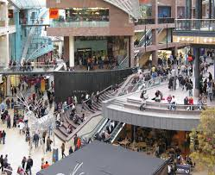
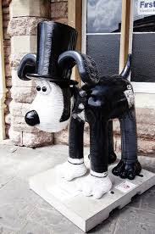
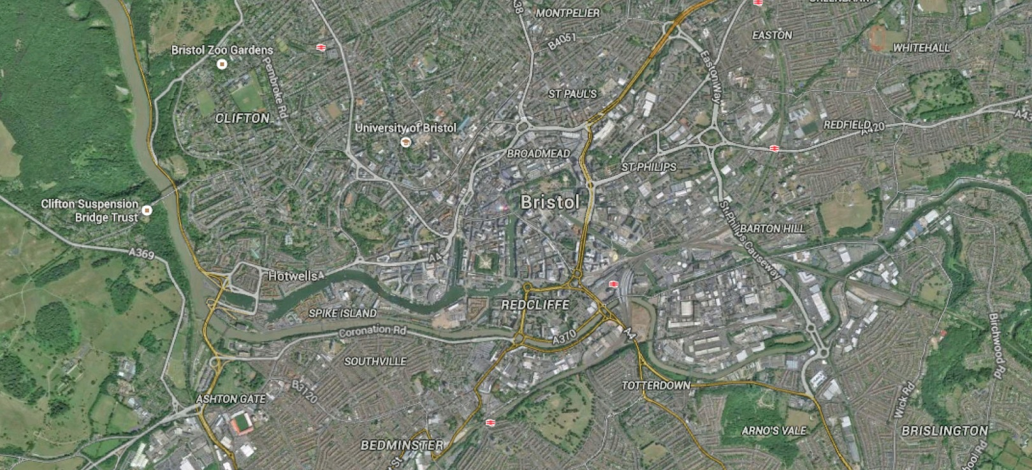
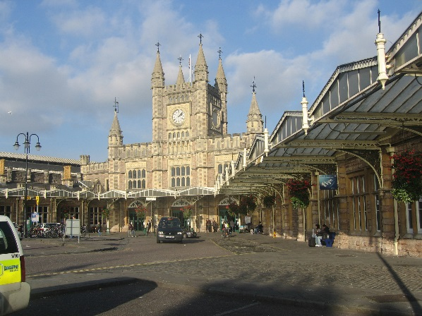
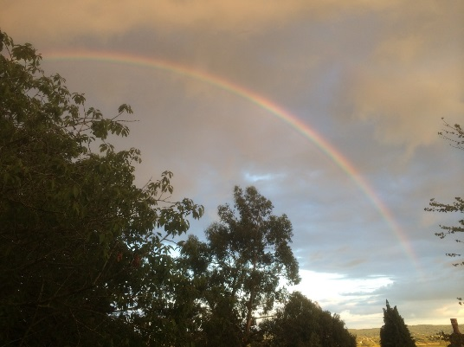
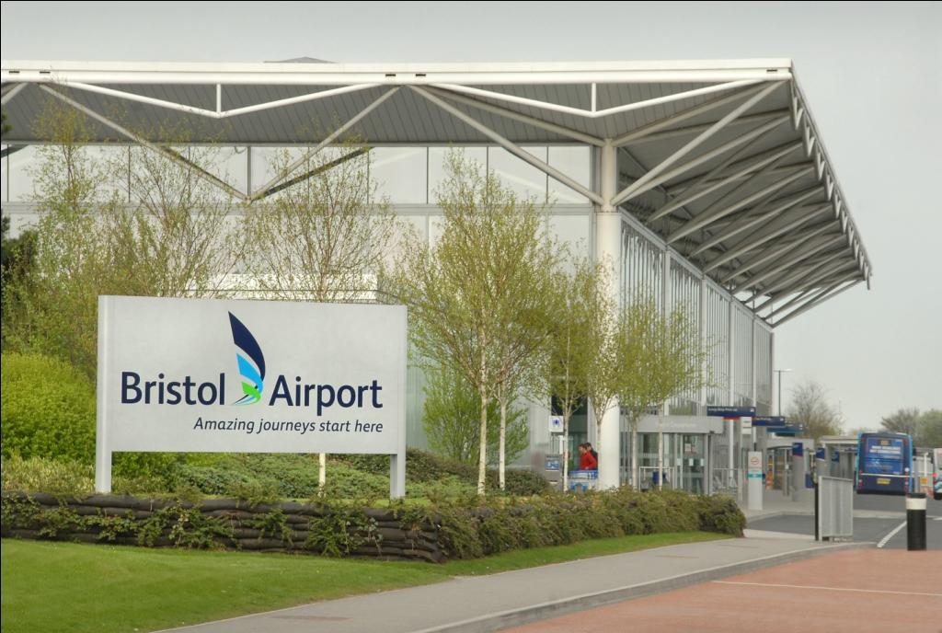
Welcome
DAPPER workshop

Slide 2
Data Analysis with Privacy Protection for Epidemiological Research (DAPPER)
Housekeeping issues
Organisation team
World Universities Network
International Population Data Linkage Conference, Swansea
Workshop agenda

Slide 3
Housekeeping
issues

Slide 4
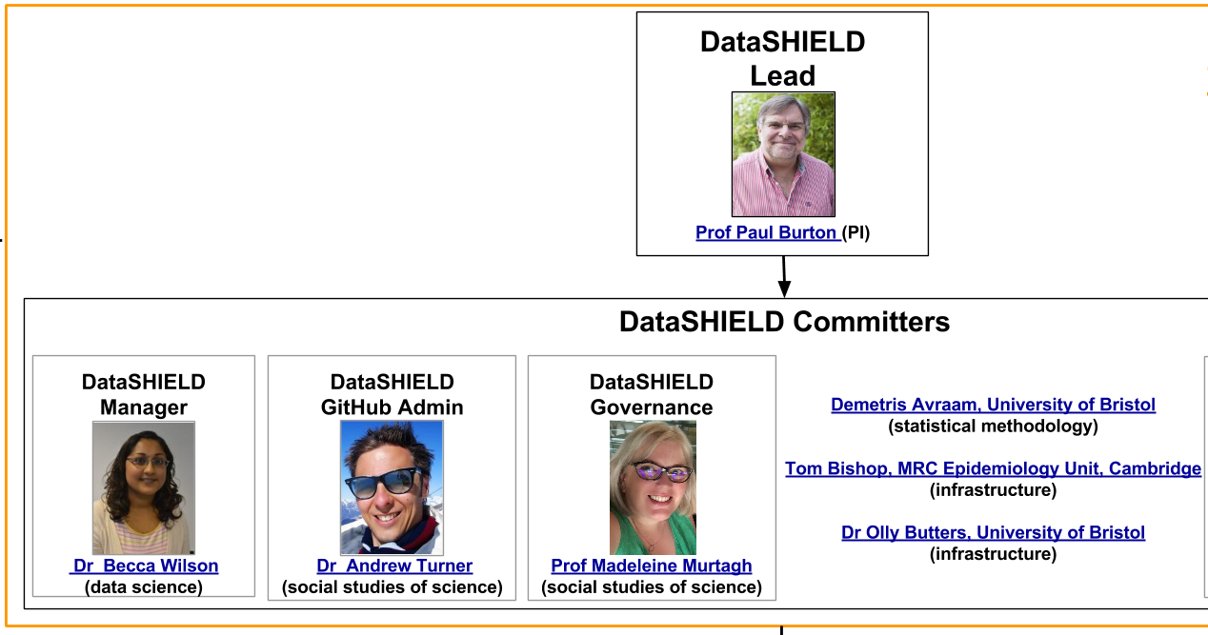
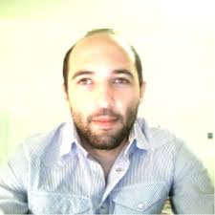
UoB DataSHIELD &
Workshop Organisation
Administration
Ingrid Randall
Stephanie Roberts
DataSHIELD
Inference
Dr Demetris Avraam
(biostatistics)
http://www.datashield.ac.uk/

Slide 5
http://www.wun.ac.uk/

Slide 6
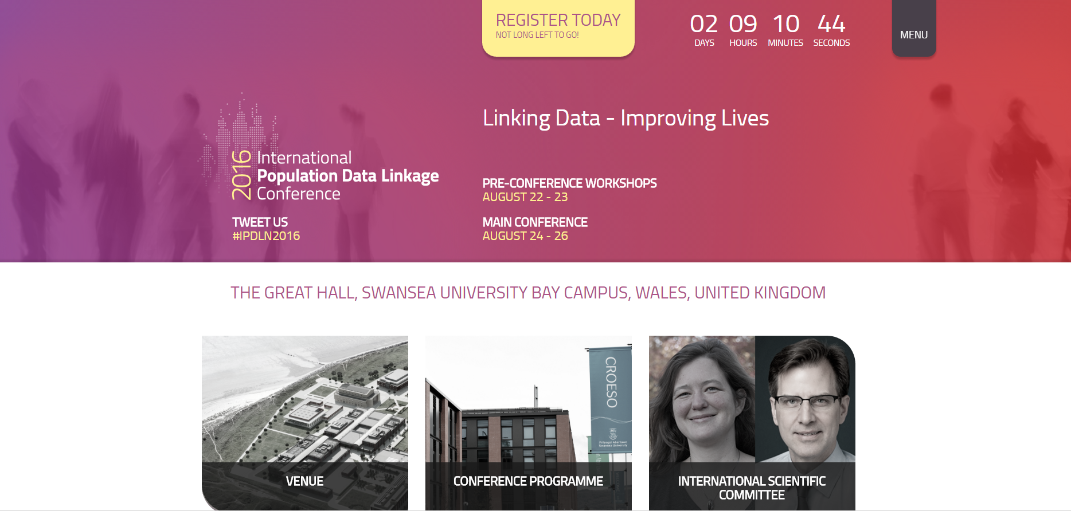
International Population Data Linkage Conference, Swansea
http://www.ipdlnconference2016.org/

Slide 7
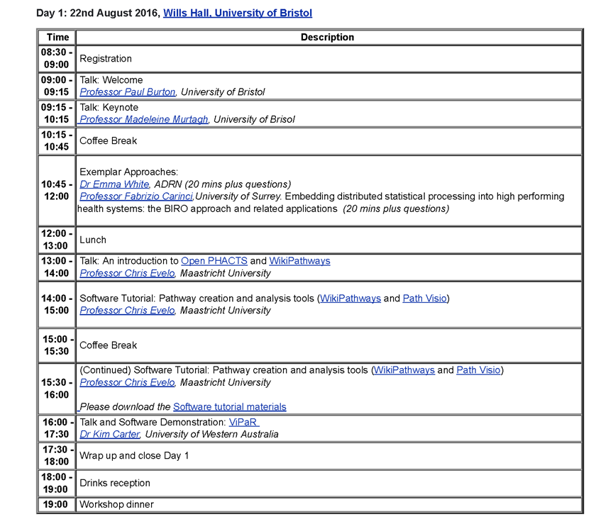
Workshop agenda

Slide 8
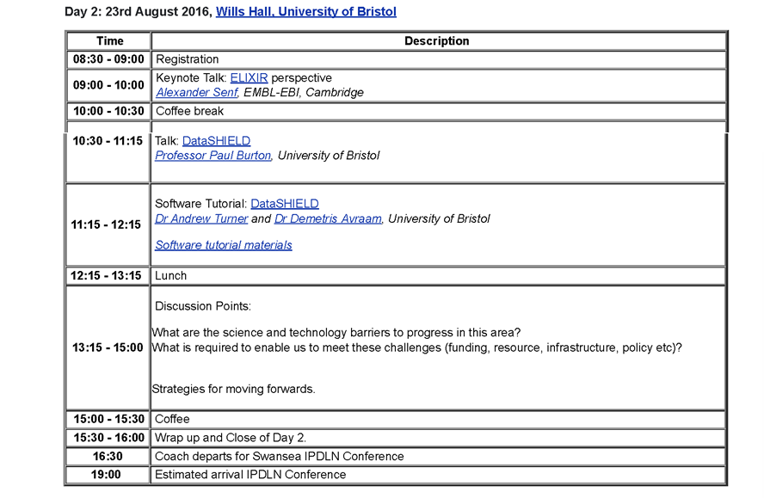
Workshop agenda
www.bristol.ac.uk/social-community-medicine/research/groups/data2knowledge/events/wun-dapper/workshop-agenda/

Slide 9
THANK YOU FOR LISTENING

