Slide 1
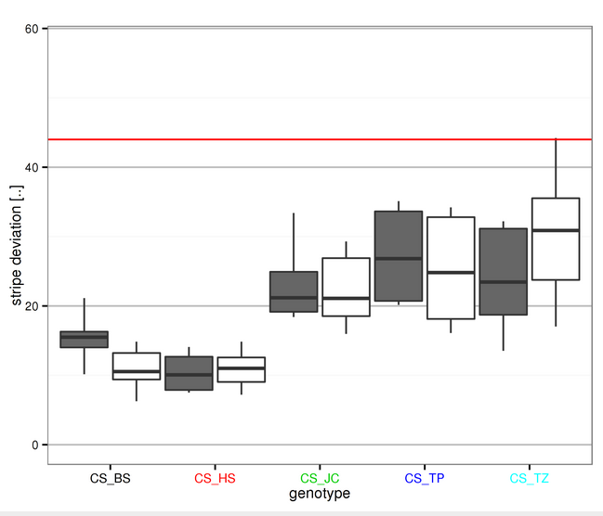
Science publishing and sensitive data
Open science publisher: F1000Research and Wellcome Open Research.
Open data aids reuse and reproducibility, sensitive data an issue. Greater moral imperative for reproducible results but ethical issues with openness.
DataSHIELD inter alia address this conflict. Can publishers help researchers access sensitive data through these tools?
Exploring approach where articles include portal enabling researchers to reanalyse described data. Via in-article analysis widget (e.g. living figures)? External site?

